Slide 1


Introduction to Software Development Methodologies Part 3: Scrum
Phil Pfeiffer
Fall, 2014
Source: Scrum Boot Camp,
John Clifford and (the late) Jerry Deville,
© 2001-2010, Construx Software Builders

Slide 2

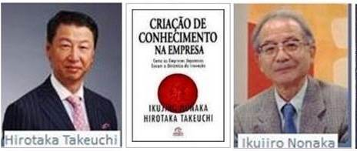

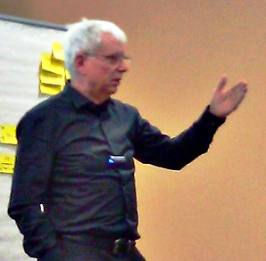
History
1985 – Described in a Harvard Business Review article by Takeuchi and Nonaka
1991 – First referred to as Scrum in "Wicked Problems, Righteous Solutions"
1995 – Elaborated in Takeuchi and Nonaka’s The Knowledge Creating Company
1995 – Described in OOPSLA paper by Ken Schwaber and Jeff Sutherland
According to Clifford and Deville, currently the most widely adopted agile process, due to simplicity and ease of implementation

Slide 3
Essentials
Definition: a process management process wrapper, with
Five roles
  Product owner
    accountable to organization for ROI
    identifies and prioritizes requirements
    determines when work is done
  Scrum master
    maintains process
    acts as sage and mentor
    ideal: servant-leader of team
      supposedly not a manager, though literature contradicts itself
  Team members – 5-9 per team
    empowered, self-managed, proactive, responsible
    determines what work to accept for each sprint
  The customer – uses team's output; represented by product owner
  Stakeholders – interested in output; represented by product owner

Slide 4
Essentials
Definition: a process management process wrapper, with
One master process: series of fixed-duration iterations
  individual iterations
    a.k.a. sprints
    typically run for up to four weeks max
    format
      first: agree with product owner to identify top N items in backlog of deliverables
      then: work on deliverables until complete or sprint ends
  sequence of iterations: sprints continue until
    backlog empty or
    product owner calls halt

Slide 5
Essentials
Definition: a process management process wrapper, with
Four artifacts
  Product backlog
    Prioritized list of discrete deliverables
    Release backlog: subset for a given release
  Sprint backlog
    Prioritized list of functionality to implement for a given sprint
    Consists of top N product backlog items, as user stories
      contents agreed on by product owner, team
    Frozen for the sprint's duration
  Sprint burndown chart
    Work to complete (y-axis) vs. time in sprint (x-axis)
  Release burndown chart
    Work to complete (y-axis) vs. time in sprint (x-axis)
  ➔ Burndown charts used for project tracking; terms like "velocity" characterize rate of progress

Slide 6
Essentials
Definition: a process management process wrapper, with
Five subordinate processes, codified as meetings
  Release planning meeting
    Covers multiple iterations (typically 3-9 months)
    Sets expectations for scope, schedule, resources
  Sprint planning meeting
    Achieves agreement on top N backlog items for current sprint
    Timeboxed: typically 2-4 hours
    Produces sprint backlog

Slide 7
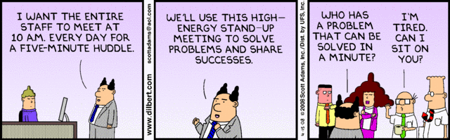

Slide 8
Essentials
Definition: a process management process wrapper, with
Five subordinate processes, codified as meetings
  Daily scrum
    Controlled by sprint master
    Limited to 15 minutes
    For announcing, not discussing
    Everyone– team first, then scrum master–
    answers the Three Questions
      What have you done since the last scrum?
      What do you plan to do before the next scrum?
      What is impeding you in your work?

Slide 9
Essentials
Definition: a process management process wrapper, with
Five subordinate processes, codified as meetings (cont.)
  Sprint review
    Timeboxed: min(4 hours, 5% of sprint duration)
    Demos of items that meet acceptance criteria
    Determination by product owner of what's done and not done
    Discussion of project status, implications for next sprint
    The one meeting that's open to the public
  Sprint retrospective
    Timeboxed: 2-4 hours
    Suggested method: all attendees write, on post-it notes,
      at least three bad things that occurred, with suggested fixes
      at least three good things that occurred
    Attendees place items on 2D graph on a whiteboard, with
    X-axis = time in sprint, Y-axis = goodness (-5 to 5)
    Team picks 1-2 items to improve for next sprint

Slide 10
Essentials
Definition: a process management process wrapper, with
Guidelines for how participants should approach work
  Team decides how much work they can do
  Team commits to doing work, in order of priority
  Team self-assigns work to meet commitments
  Management commits to giving team uninterrupted work time
  Commitments are promises to deliver – not to try
    No partial credit for incomplete work – work is either done or not
Chickens and pigs
  Characterizations of how well participants live up to roles
    Pigs commit to responsibilities
    Chickens don't
      Not authorized (e.g.) to speak at scrums

Slide 11
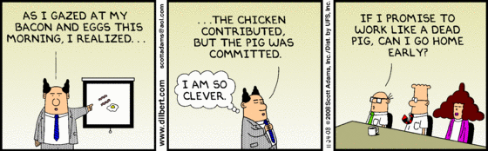

Slide 12
User Stories
Scrum's version of WBSes
Format: as a <role X> I want <capability Y> in order to <achieve business-related goal Z>
Desired attributes: INVEST
  Independent (from one another) as much as possible
  Negotiable
  Valuable
  Estimate-able – not too big, not too ambiguous
  Small – can be completed in a sprint by a few people
  Testable – binary acceptance criteria

Slide 13
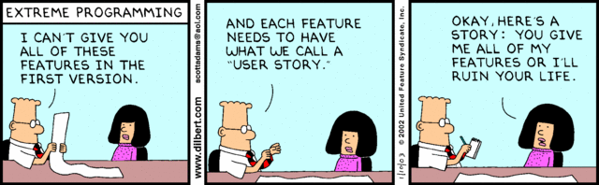

Slide 14
Epics
User stories that are too big to complete in one iteration
Need to be decomposed into series of user stories
Tasks
Components of user stories
Can be completed by one person in ½ - 2 days
Used to estimate time to complete, not time worked
Themes
Aggregations of related user stores – e.g., for a feature
Useful to communicate release planning to stakeholders

Slide 15
Estimation
Within releases, early on: "T-shirt sizing"
  Product owner estimates value: XS, S, M, L, XL
  Team estimates effort: XS, S, M, L, XL
  Product * value w.r.t. some metric allows for early prioritization
Within sprints
  Managed with user story points
  Rough measure of effort – not duration

Slide 16
Other
Much of Construx seminar devoted to classic principles from project management: e.g., PMOs, four stages of team development
Comment on seminar from ETSU alumnus Bobby Whitten
  Scrum is how you produce software, once you know what you’re producing
  The “magic” (requirements, system architecture) that makes this work happens elsewhere

